Slide 1
MILANO ROMA GENOVA BARI

Slide 2
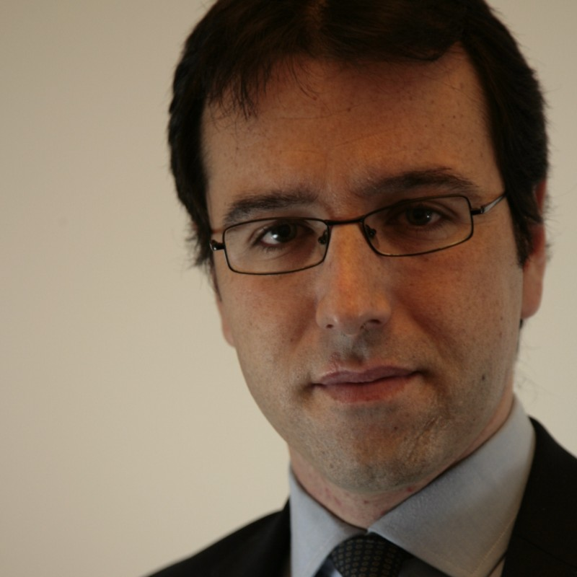
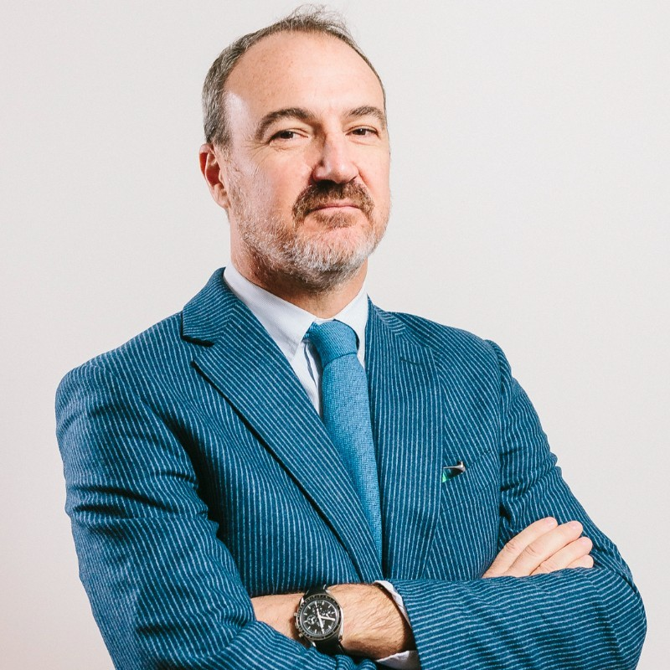
PRACTICE AREAS
STANDARD TASK
Administrative, Public law & Bids
Bank & Finance Law
Civil Law
Commercial Law
Corporate Governance
Criminal Law
Maritime & Transport
Family Law
Bankruptcy & Restructuring
Immigration & Global Mobility
Intellectual Property
International
Labor & Employment
Litigation & Arbitration
Privacy & Data Protection
Real Estate
Tax Advisory & Planning
SPECIAL TASK
Legal Tech, Legal Design, Digital Innovation
Avv. Guido Medina
medina@agnolibruzzonegenovesi.it
M&A, Buyout, Strategic Alliance
Avv. Andrea Cesana Avv. Marcello Agnoli acesana@agnolibruzzonegenovesi.it agnoli@agnolibruzzonegenovesi.it
Institutional relations
Avv. Aldo Bruzzone Avv. Gianemilio Genovesi
bruzzone@agnolibruzzonegenovesi.it genovesi@agnolibruzzonegenovesi.it

Slide 3
thank you!

